Slide 1

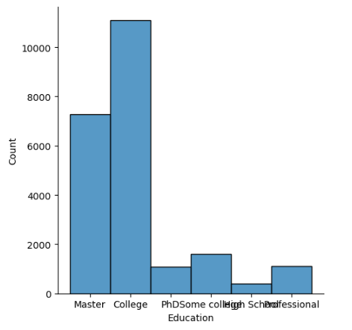
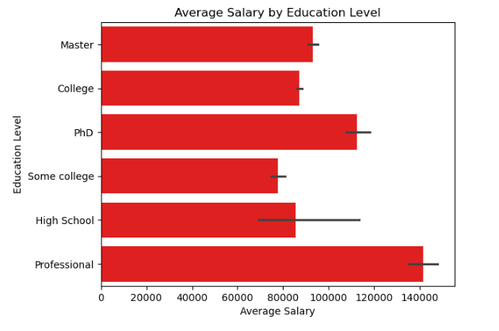
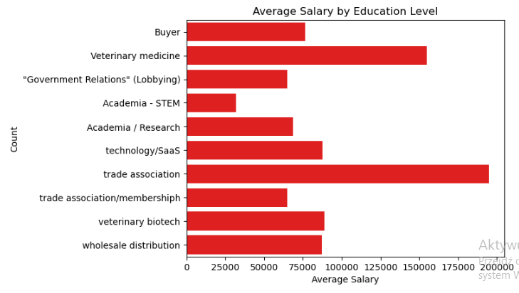
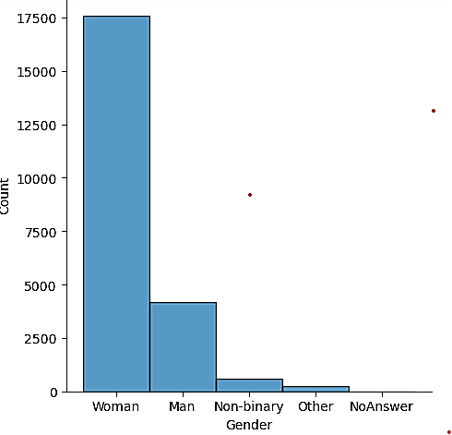
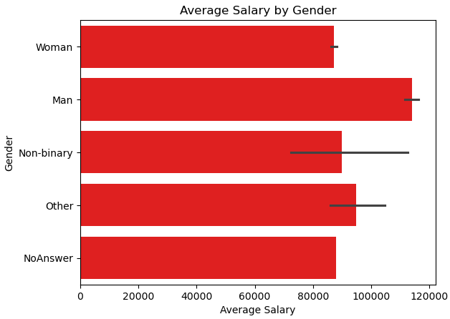
8178
L7_CA_1_Salary Survey
Agnieszka Malara
Introduction
Results
Analizing slaray survey dataset to identifie correlations between, age, gender, industry.
Investigating dataset by useing EDA proces and detecting and identifiyng errors, cleaning data, removing outliers, handling duplicates.
Using visualisation methodes to present results.
Correlation between Salary and Education
There is large disporoportion between highly educated population at 37.2% and not highly educated population at 62.8%. Data shows that individuals with higher education have notably higher salary.
Methods
Importing Python libraries
Using df.head(), df.shape, df.info(), and df.types() codes to identify the salary survey dataset consisting of 23 columns and 28178 rows and data types foats64 and objects.- Renaming columns and dropping columns that represent no relevant information
Using missing_values_formats to allow Pandas to recognize corrupted values.
Setting the float format to display with 2 decimal places for the salary column and removing commas.
Detecting and dropping all Nan values
Checking and dropping duplicate values
Defining currencies and converting to USD
Indicating the outlier rows for salary and overtime bonus and removing them.
Creating gender, education, and industry data frames and calculating average salary distribution by gender, education, and industry.
Corelation between Salary and Industry
The analyses showd that certain sectors earn higher. High salary sectors are trade Assosiation and Veterynary medicine. The low salary sectors are Academia STEM and Goverment relationships.
Results
Correaltion between Salery and Gender
This analisis shows gender imbalance and disparity in salary distribution . Although woman form majority population in this salary data of 77.89% their avarage salary is the lowest among all genders apart from those that prefered not to answer. Compering Man population18.49% which is saginificatnly smaller group than woman have the highest salary. Non binary and others have lower salary than man but higher than woman.
Conclusions
This analisis shows gender imbalance and disparity in salary distribution between Female and Male. Despite woman are making 77,89% population their avarage salary is the lowest. This disparity shows that gender plays sagnificant role in salary difrences.
This analyses indicates that higher education can be beneficial to increase income.
From this analysis, it's clear that industries sectors offer divers salaries, which can be influenced by factors such as required skills or education.
References
Almog Woldenberg (2018). Pandas convert data type from object to float. [online] Stack Overflow. Available at: https://stackoverflow.com/questions/48094854/pandas-convert-data-type-from-object-to-float.
NARAYAN (2021). How to convert currency in a database using pandas. [online] Stack Overflow. Available at: https://stackoverflow.com/questions/68103246/how-to-convert-currency-in-a-database-using-pandas?newreg=7c3b944f0db149fb9953d6186c190978.
Stack Overflow. (n.d.). python - pandas: return average of multiple columns. [online] Available at: https://stackoverflow.com/questions/49560809/pandas-return-average-of-multiple-columns.
Our Dedication.Your Journey.
www.cct.ie

